Slide 1
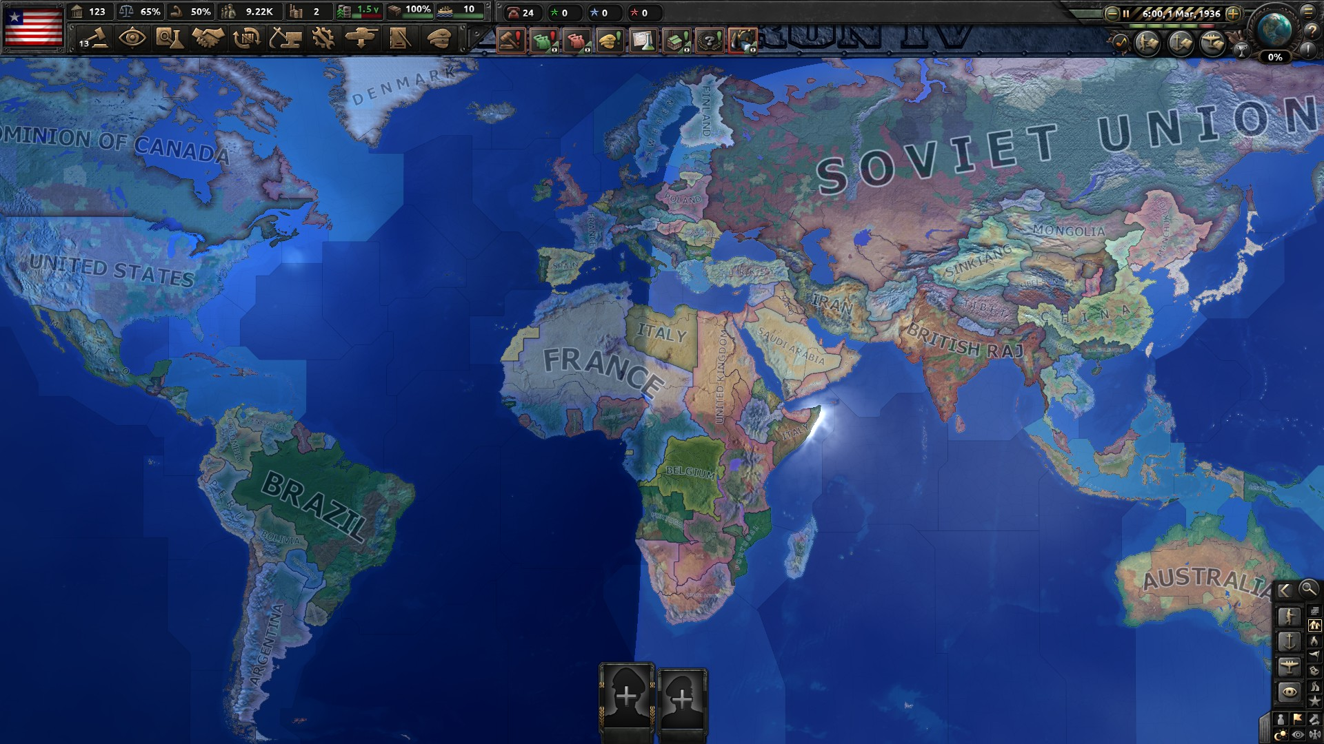
EOE’s
MAP MOD
STANDARD
WORLD
MAP

Slide 2
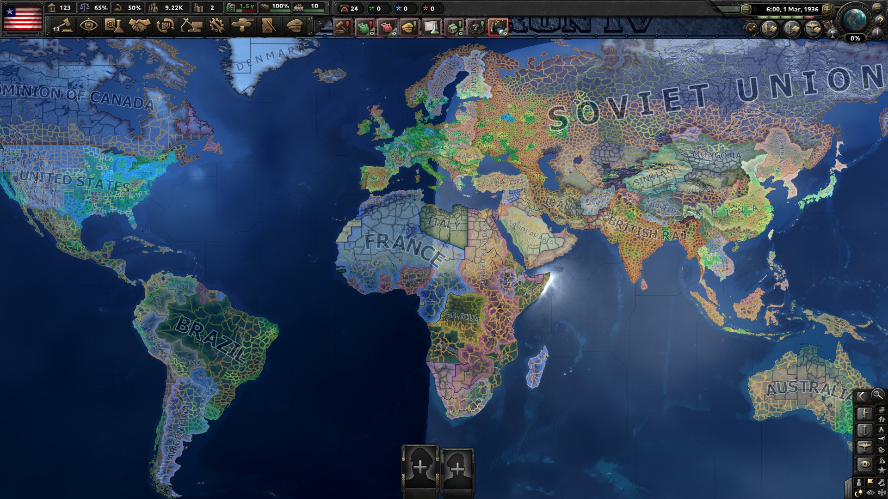
EOE’s
MAP MOD
TOTAL 9977
(+9143)
1200% MORE
STATES

Slide 3
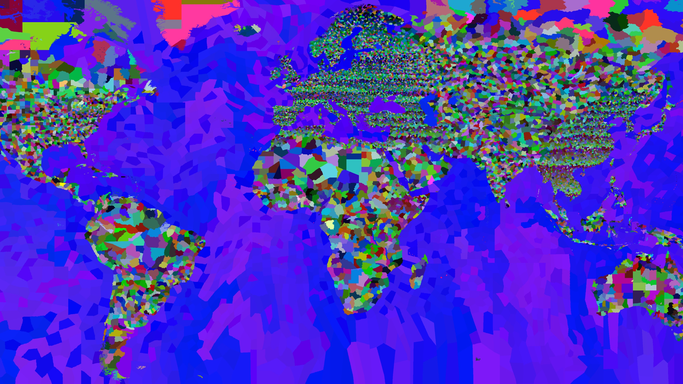
EOE’s
MAP MOD
TOTAL 18839
(+5604)
150% MORE
PROVINCES
EUROPA
CHINA
MIDDLE EAST
NORTH AFRICA
SE-ASIA
HORN OF AFRICA

Slide 4
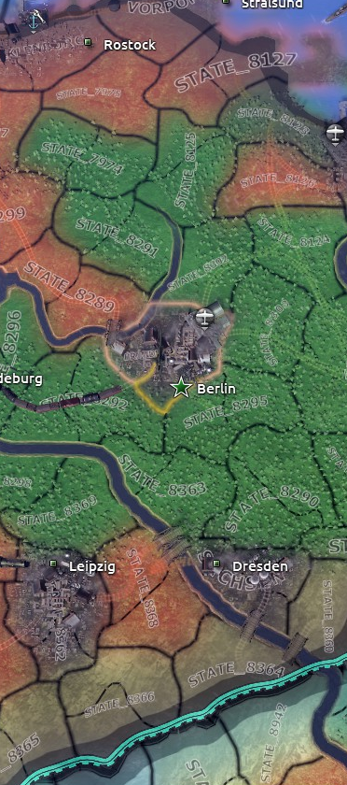
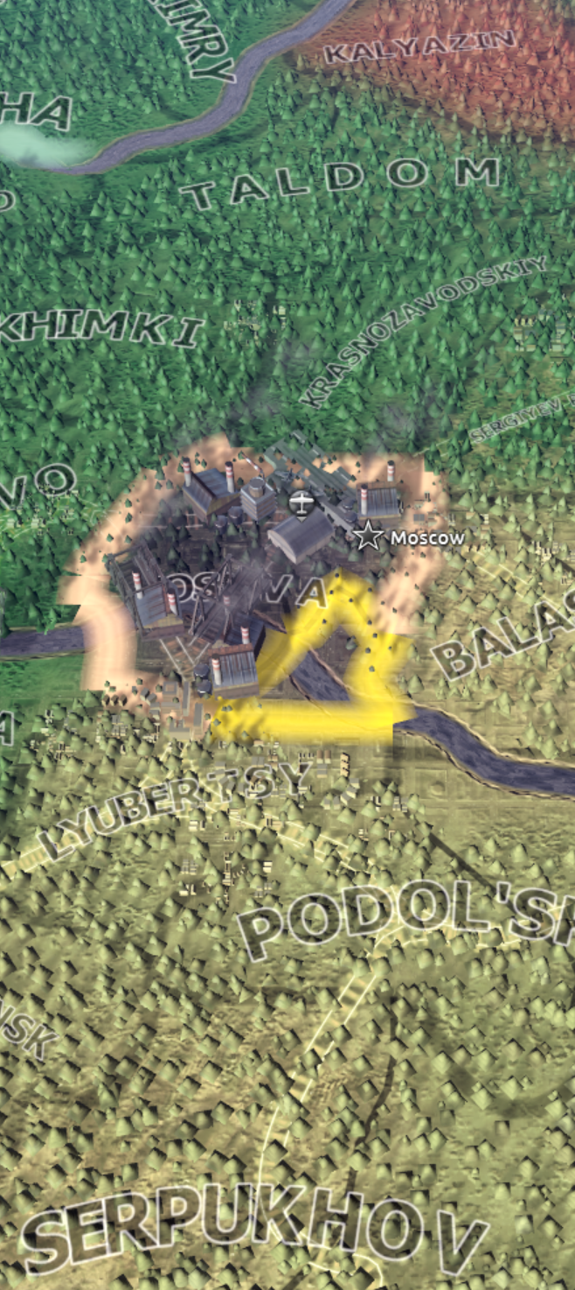
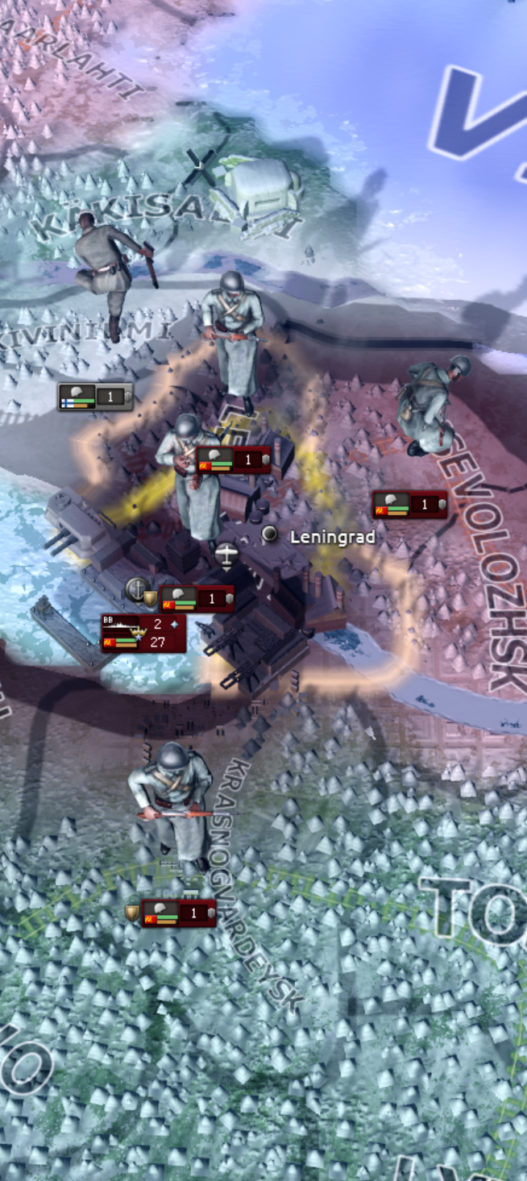
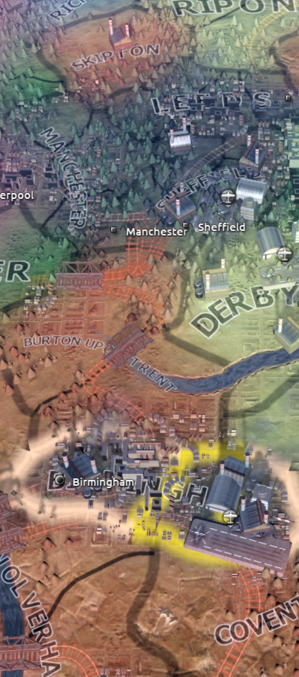
EOE’s
MAP MOD
MORE TILES
FOR URBANS

Slide 5
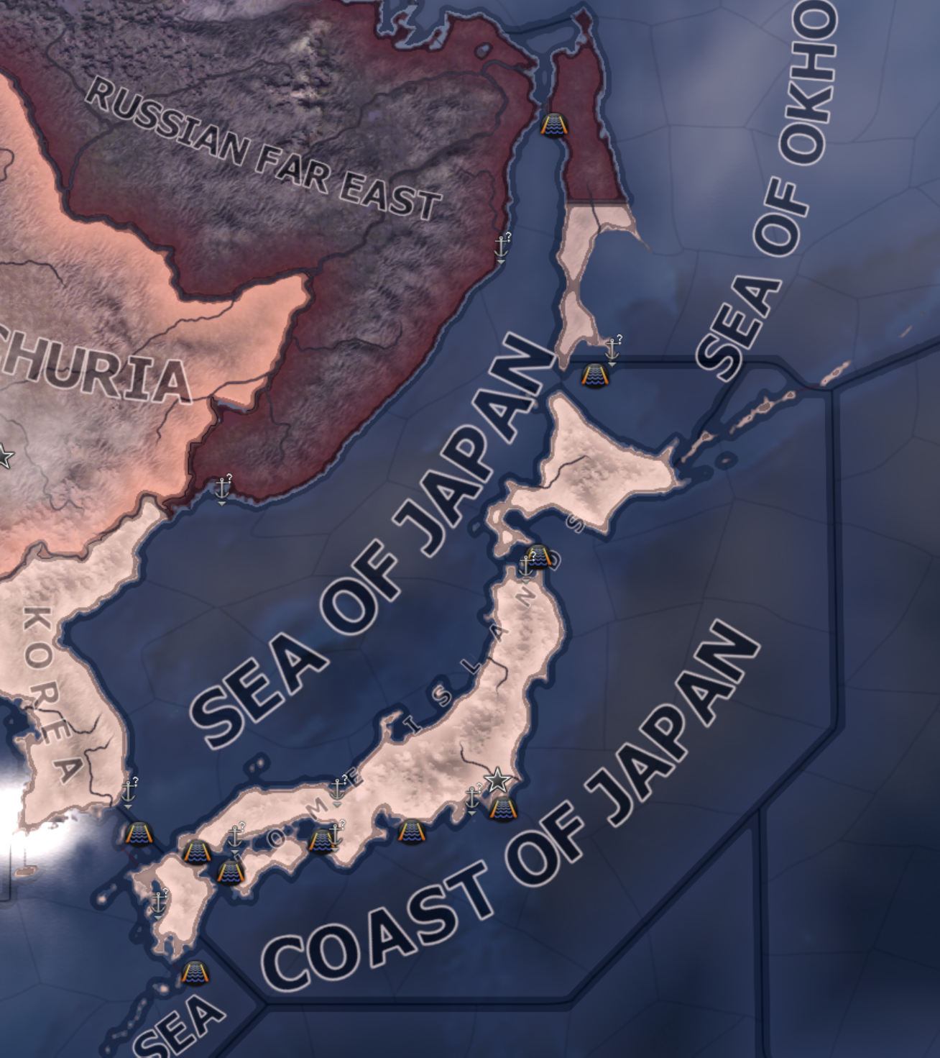
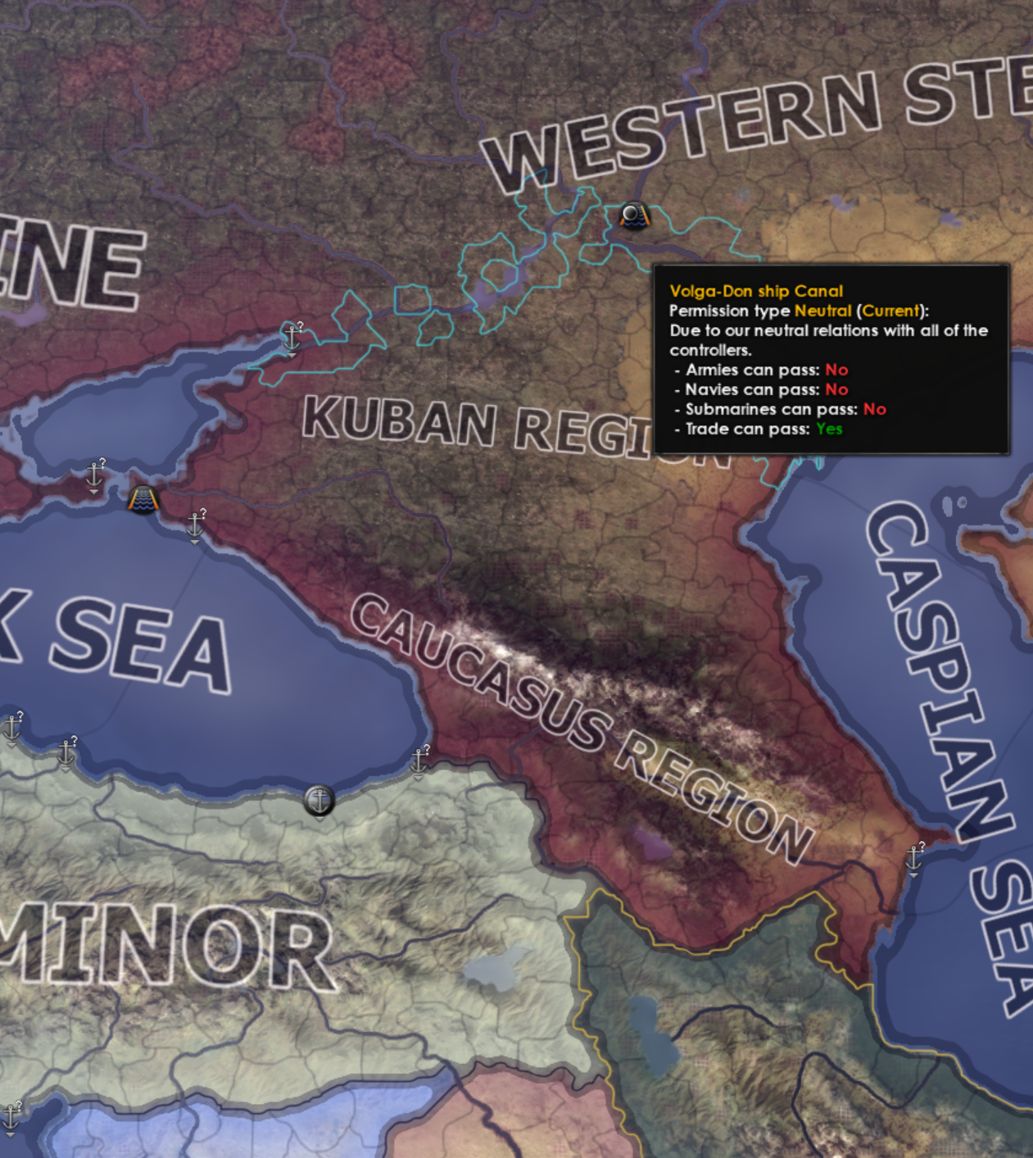
EOE’s
MAP MOD
MORE STRAITS
Volga-Don Canal
Tartary Strait
Sōya Strait
PASSABLE
CASPIAN SEA
TRUE SEA OF JAPAN
Stugaru Strait
Korea Strait
Tokyo Bay
Kanmon Strait

Slide 6
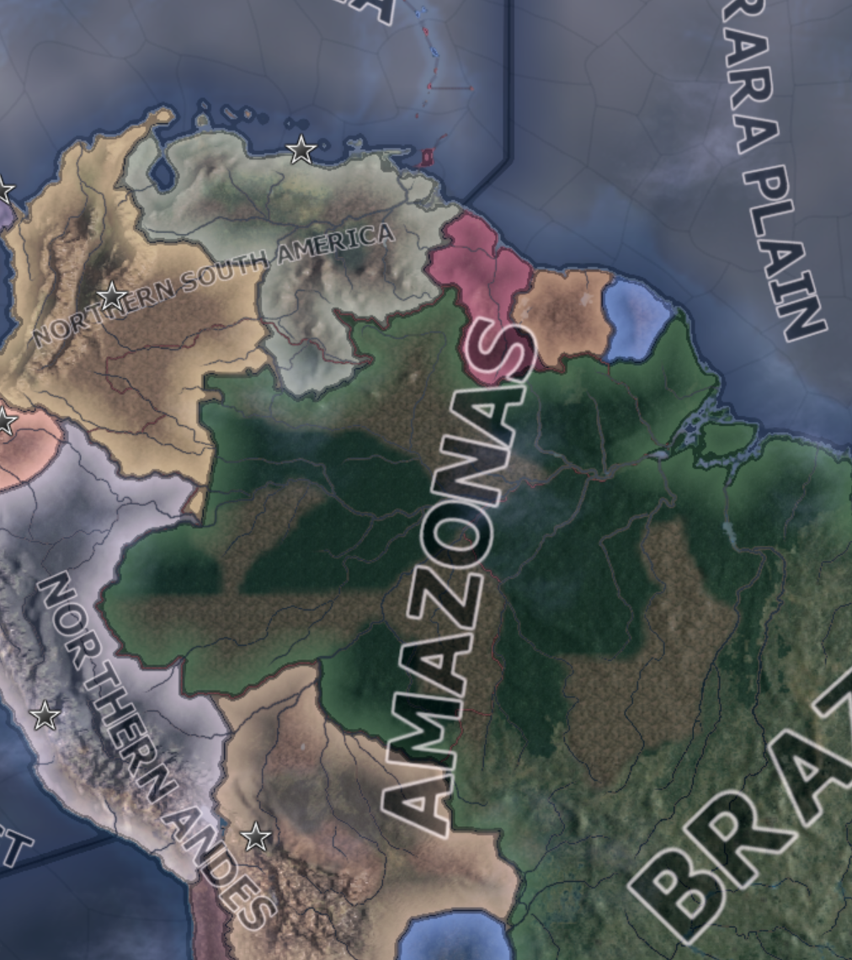
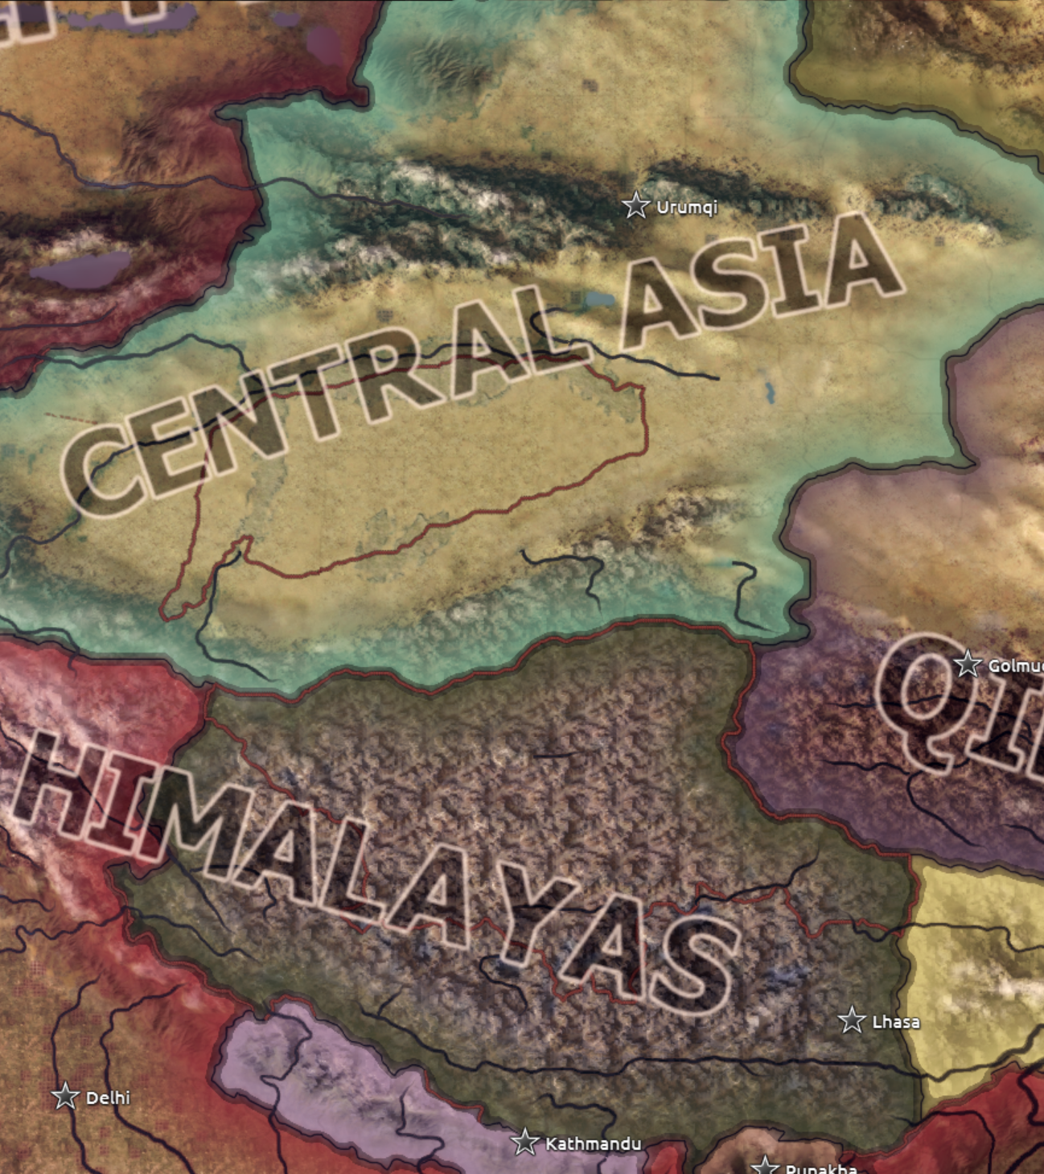
EOE’s
MAP MOD
MORE IMPASSABLE MOUNTAINS/DESERTS
TAKLIMAKAN
DESERT
AMAZON RAINFOREST
QINGHAI-TIBET
PLATEAU

Slide 7
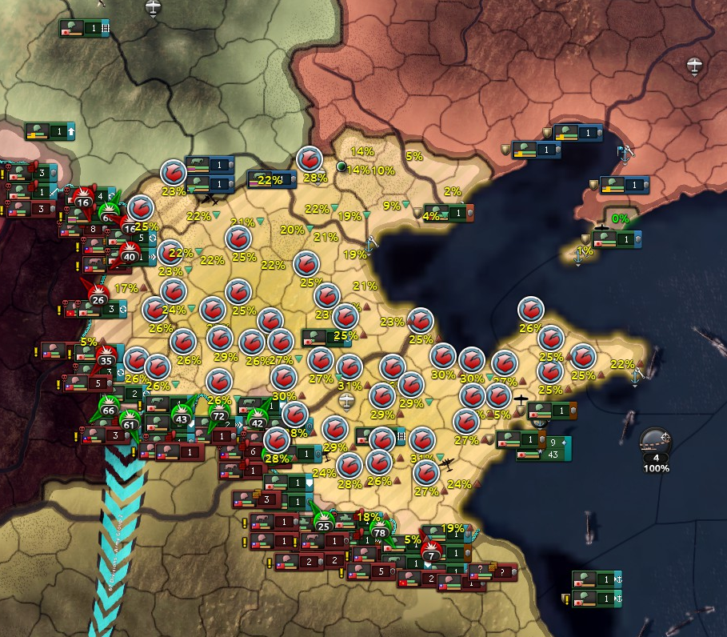
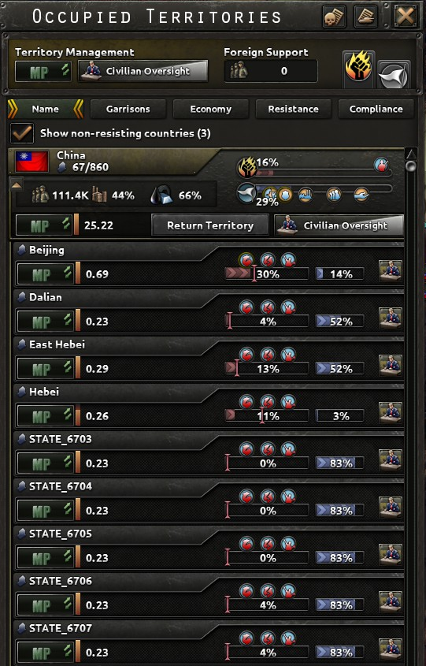
EOE’s
MAP MOD
NEW
SUPPRESSION UNIT

Slide 8
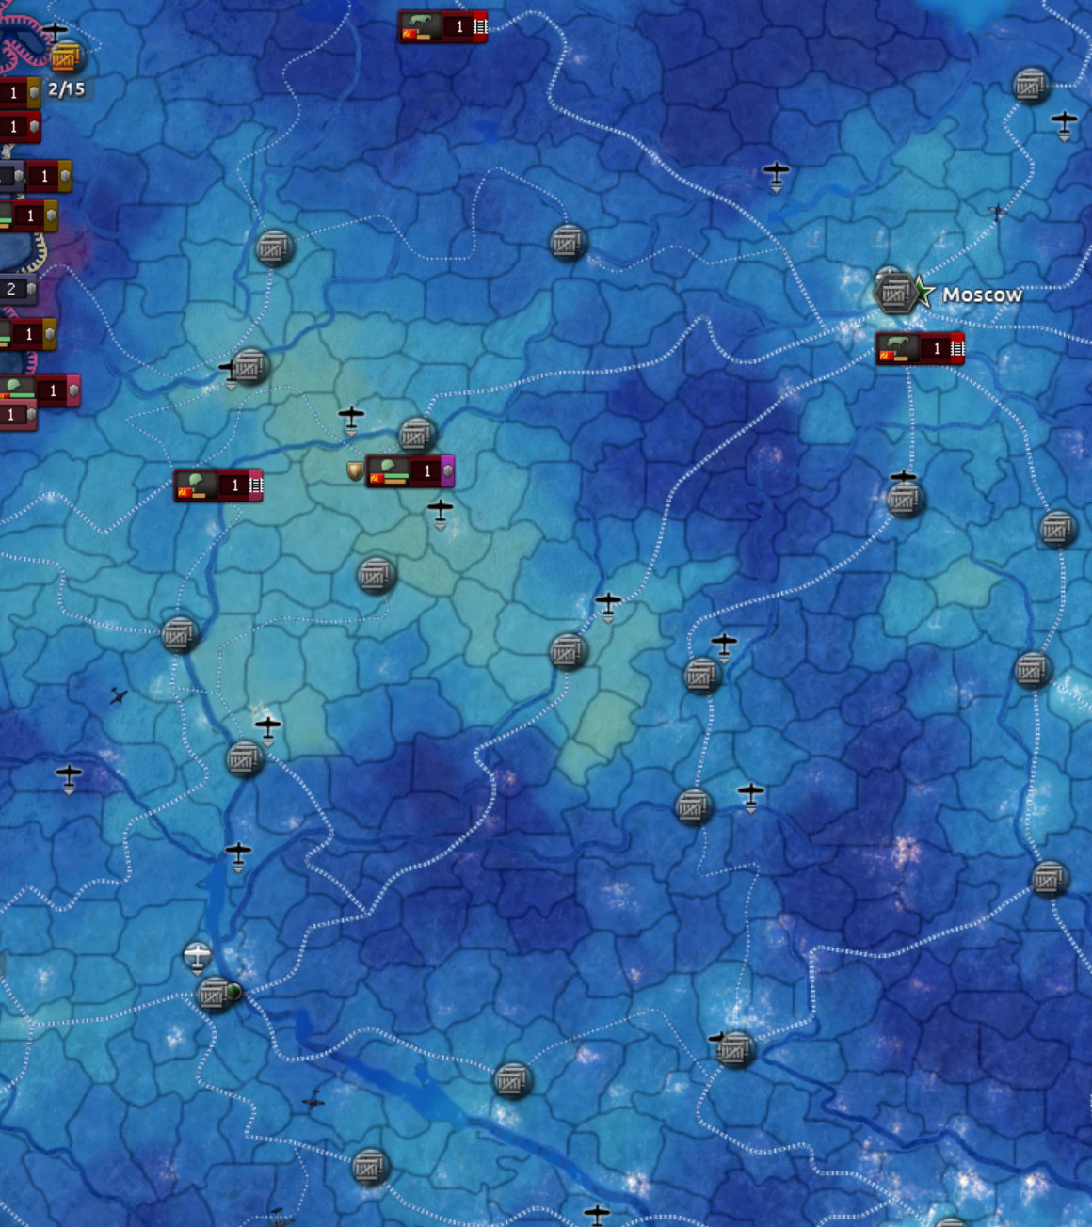
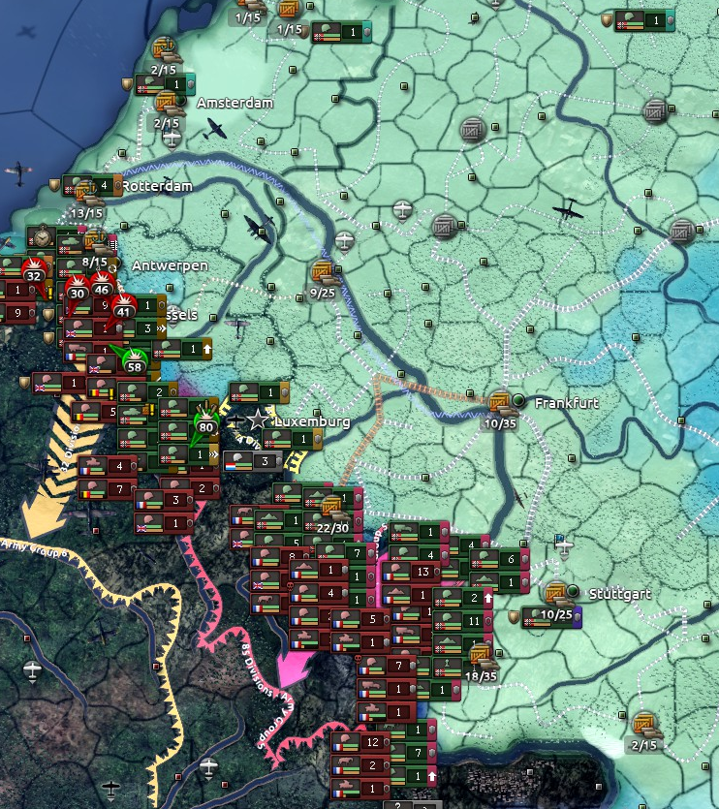
EOE’s
MAP MOD
RAILWAY

Slide 9
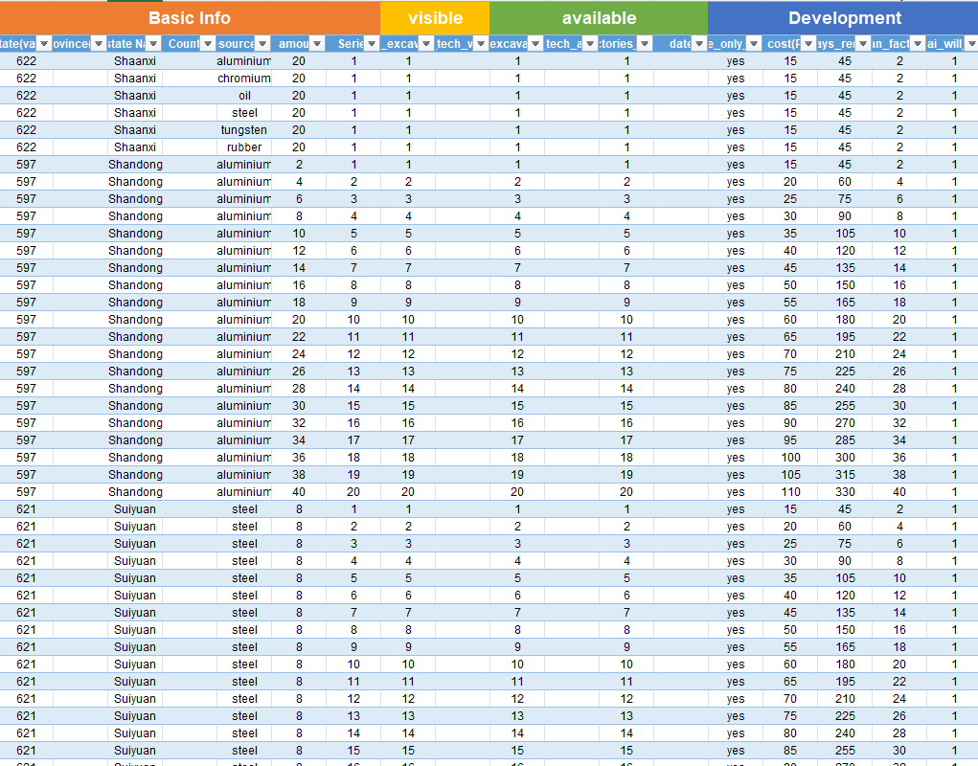
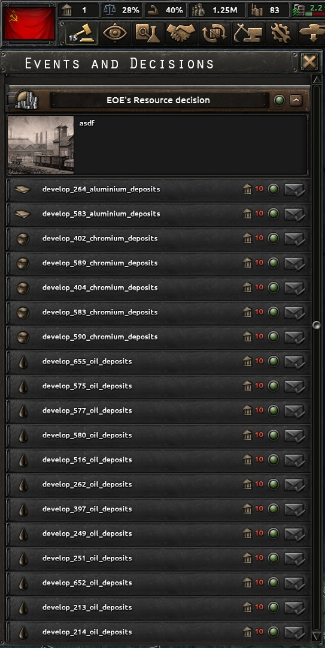
EOE’s
MAP MOD
MORE RESOURCES
(BETA)

Slide 10
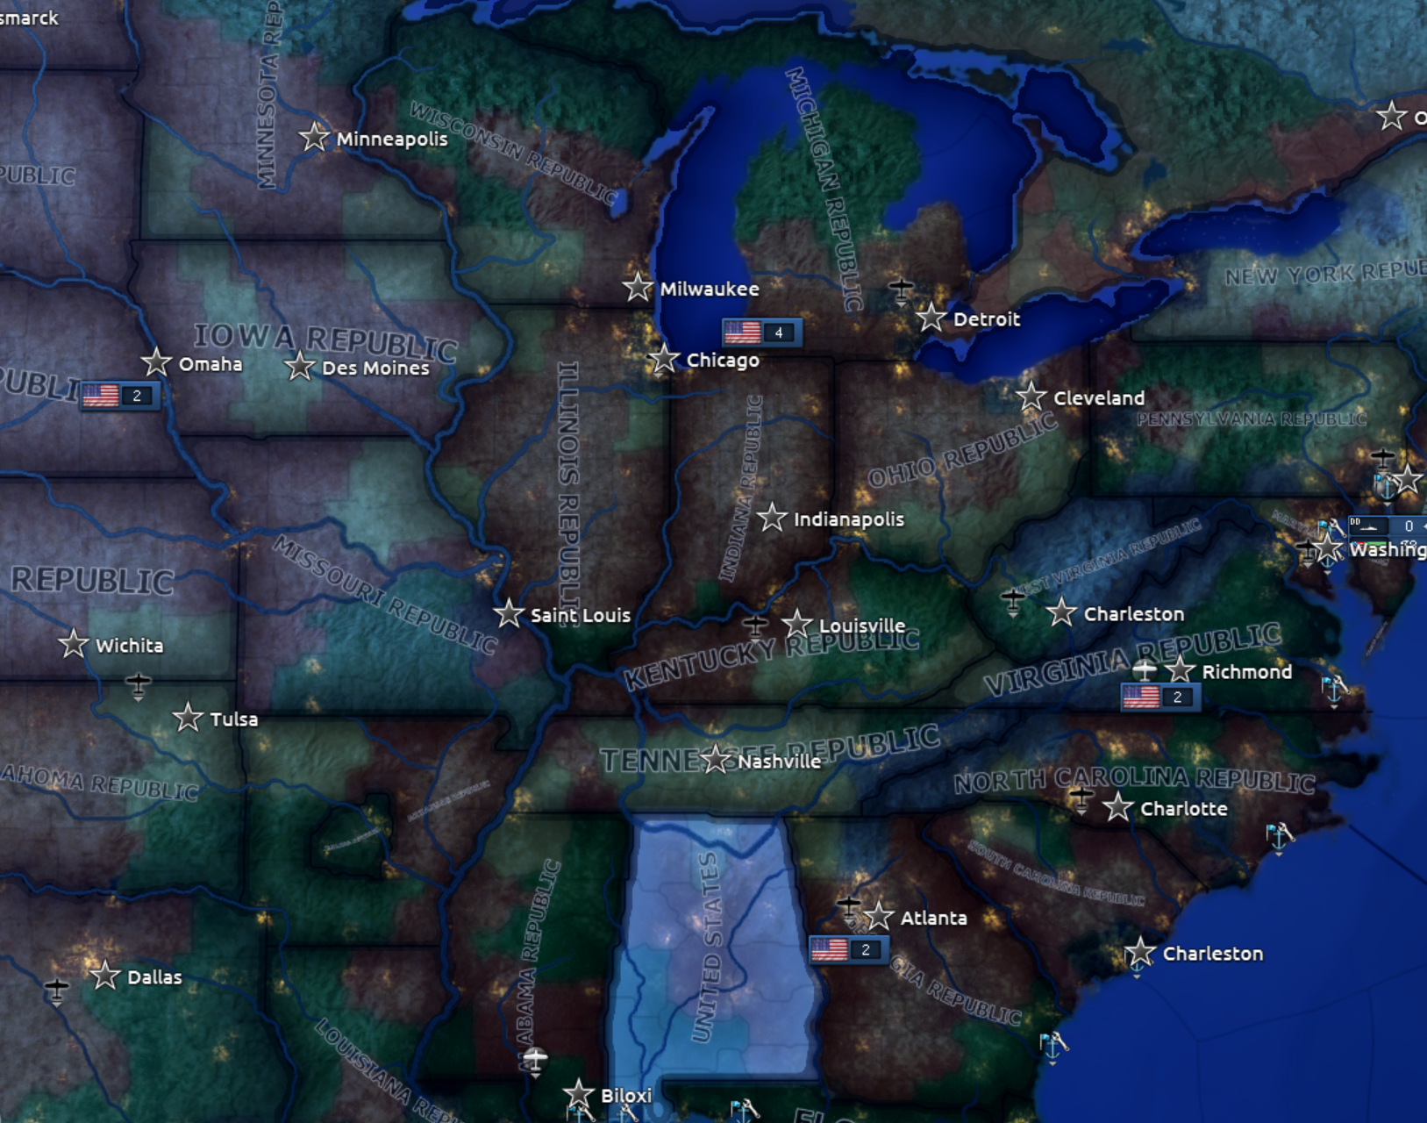
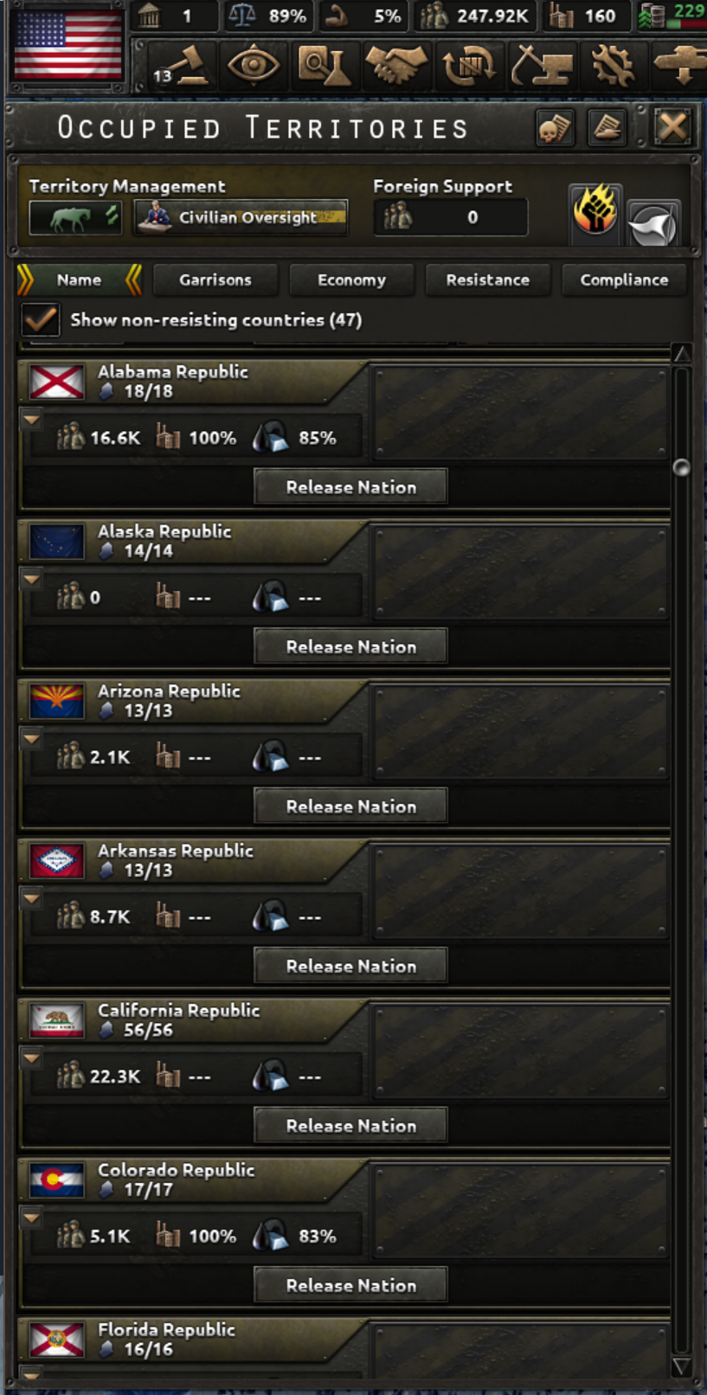
EOE’s
MAP MOD
MORE
COUNTRIES
（BETA）

